Slide 1
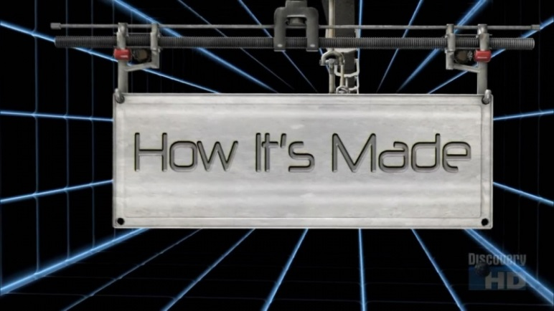
How Its Made
How it’s Made : Cars Motorbikes Engines

