Slide 1
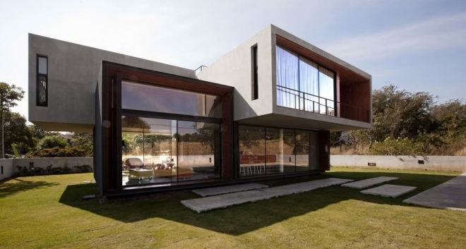
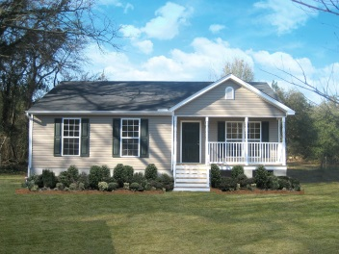
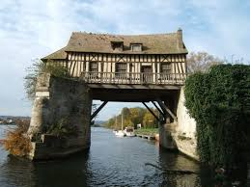
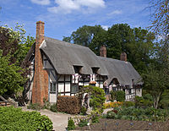
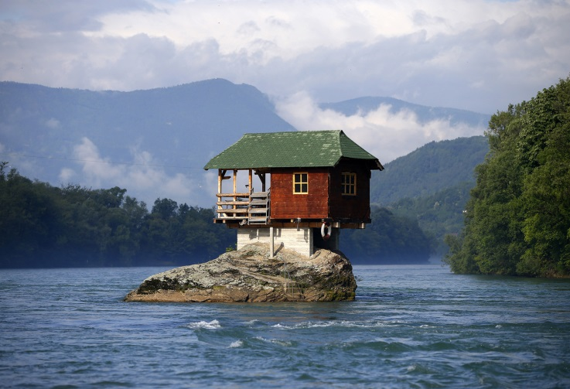
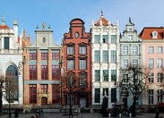
Home English cottages French bungalows Dutch townhouses German mansions Canadian castles Boathomes and motorhomes About me
I LIKE HOUSES A LOT. HERE IS A SITE WHERE I SHARE NICE IMAGES AND FUN FACTS ABOUT DIFFERENT HOUSES IN RANDOM PLACES AROUND THE WORLD.
FROM BUNGALOWS TO BOATS… FROM HOLLAND TO CANADA , THIS SITE INCLUDES A WIDE RANGE OF HOUSES AND PLACES.
MY GOAL IS TO MAKE THE BEAUTY OF A HOME SHINE IN ITS NATURAL HABITAT AND MAKE PEOPLE REALISE THAT IT’S NOT JUST SOMEWHERE TO KEEP THE RAIN OFF YOUR HEAD, BUT A PLACE TO WORSHIP LIKE THE GOD THAT IT IS.
~ A HOUSE IS MADE FROM WALLS AND BEAMS, BUT A HOME IS MADE FROM HOPES AND DREAMS ~
~ THE MAGIC THING ABOUT HOME IS THAT IT FEELS GOOD TO LEAVE, BUT IT FEELS EVEN BETTER TO COME BACK ~

Slide 2
Home English cottages French bungalows Dutch townhouses German mansions Canadian castles Boathomes and motorhomes About me
I like houses a lot. Here is a site where I share nice images and fun facts about different houses in random places around the world.
From bungalows to boats… From Holland to canada , this site has a range of houses and places.
MY GOAL IS TO MAKE THE BEAUTY OF A HOME SHINE IN ITS NATURAL HABITAT AND MAKE PEOPLE REALISE THAT IT’S NOT JUST SOMEWHERE TO KEEP THE RAIN OFF YOUR HEAD, BUT A PLACE TO WORSHIP LIKE THE GOD THAT IT IS.
~ THE MAGIC THING ABOUT HOME IS THAT IT FEELS GOOD TO LEAVE, BUT IT FEELS EVEN BETTER TO COME BACK ~
~ A HOUSE IS MADE FROM WALLS AND BEAMS, BUT A HOME IS MADE FROM HOPES AND DREAMS ~

